Slide 1
Abstract algebra ch 33 cyclometric extensions

Slide 2
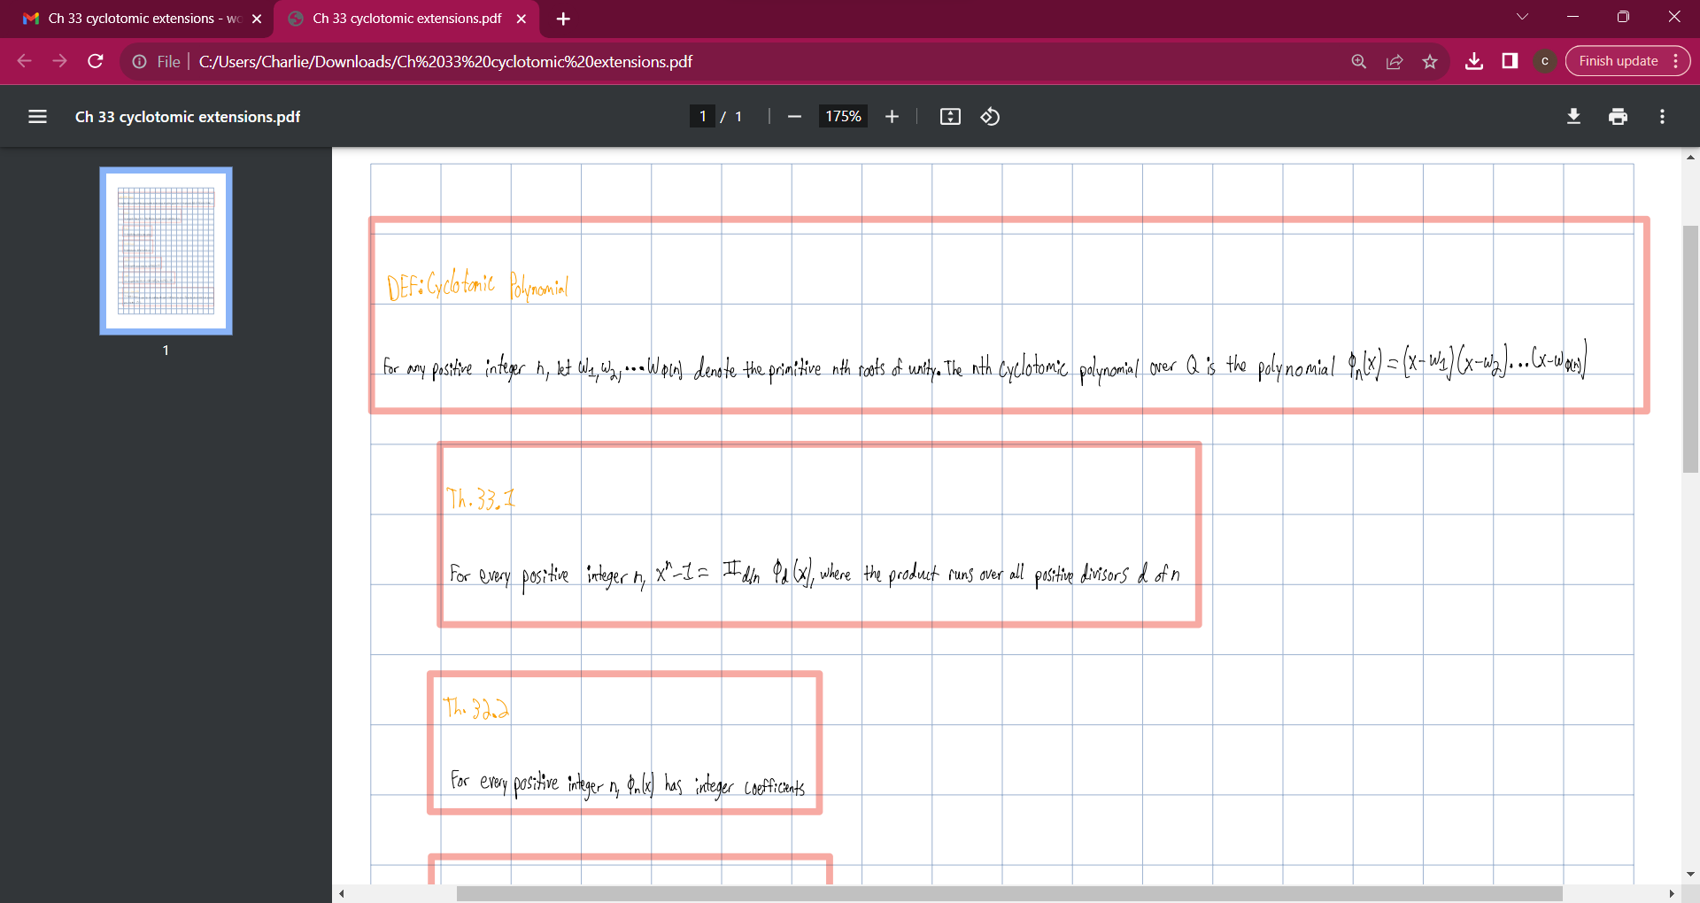

Slide 3


Slide 4
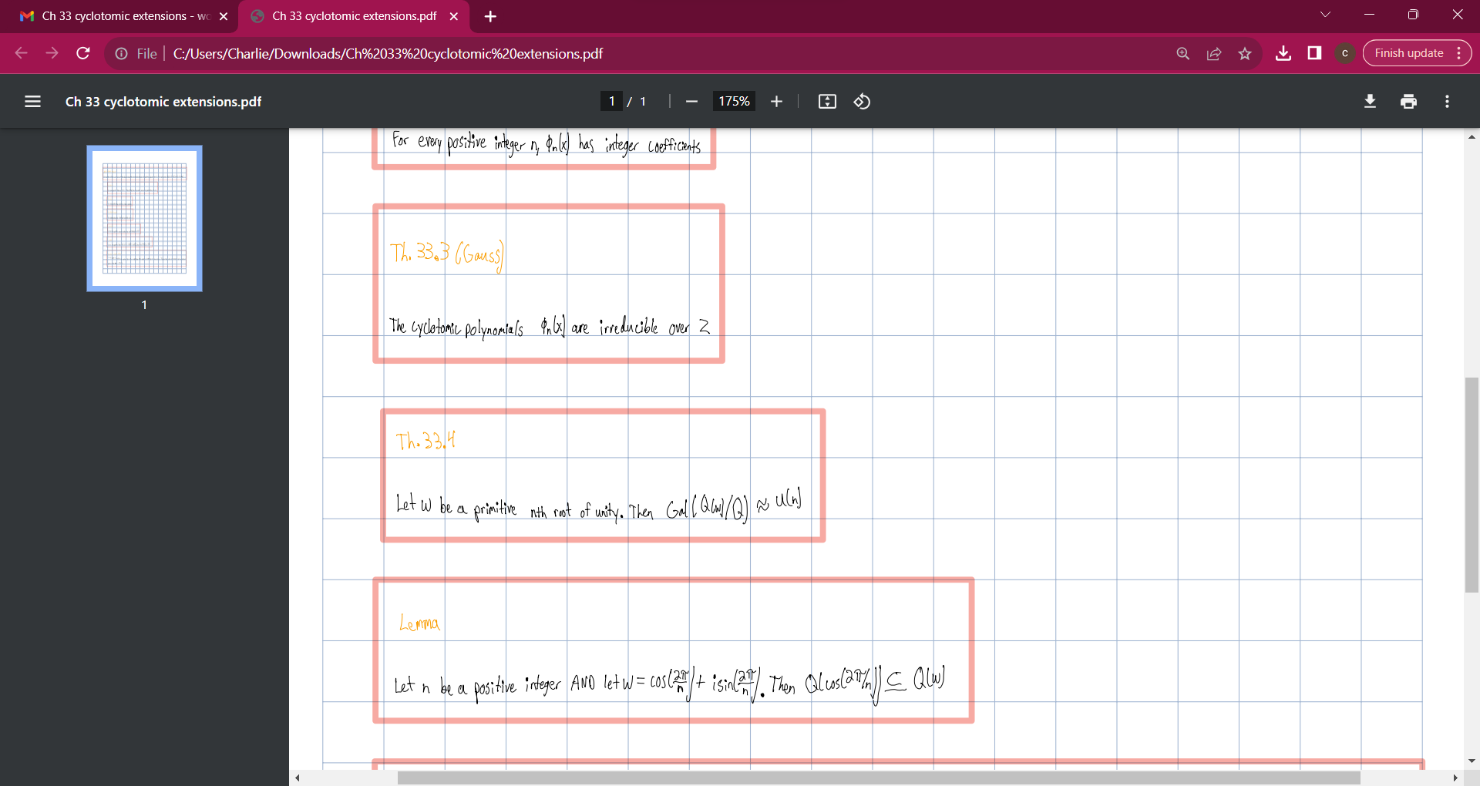

Slide 5
